Slide 1
Policy Evaluation

Slide 2
Objectives
Immediate and long-term goals
Reward, Return and Value functions
Random Walk Environment
Monte Carlo prediction (MC)
Temporal-Difference Learning (TD)
n-steps TD
TD(𝜆)
Backward-view TD(𝜆)
Comparison

Slide 3
Immediate and long-term goals
Balancing immediate and long-term goals is challenging
should I watch Netflix tonight?
immediate satisfaction
keep studying reinforcement learning?
maybe (and only maybe) will provide much higher satisfaction in the long term
How much more satisfaction exactly?
I don’t know, you don’t know, and we won’t know unless we try it out, unless we explore it
Life doesn’t give us its MDP transition function!
we need to balance information gathering and information utilization
considering long-term effect and not only the current situation
We need agents that can learn to estimate the value of policies
like the policy-evaluation method of Dynamic Programming
this time without the MDP

Slide 4
Reward, Return and Value functions
Reward: the one-step signal the agent gets
agent observes a state, selects an action, and receives a reward signal
not what the agent is trying to maximize
if agent maximizes reward, in the long-term, it’s getting less than it could
Return: the total discounted rewards
how much reward the agent obtains in an episode
a better indicators of performance: it contains a long-term sequence
isn’t what an agent tries to maximize
if agent maximizes return, it may find a policy that takes it through a noisy path: sometimes this path will provide a high return, but perhaps most of the time a low one
Value function: the expectation of returns
we want high returns, but high in expectation (on average)
agent has to maximize the expected total discounted reward

Slide 5

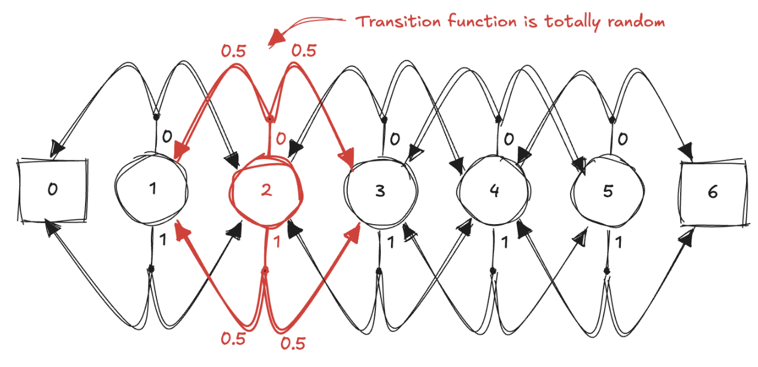
Random Walk Environment
A single-row grid-world environment
five non-terminal states
the agent has no control of where it goes!
probability of going left is equal to the probability of going right
the goal is to estimate the expected total discounted reward the agent can obtain given these circumstances
Useful when focusing on the evaluation problem
the dynamics of the environment make policy being evaluated irrelevant

Slide 6

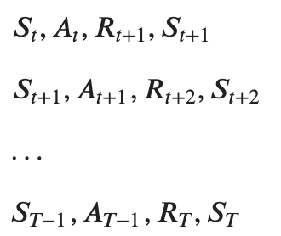
Monte Carlo prediction (1)
The goal is to estimate the state-value function 𝑣_{𝜋}(𝑠) of a policy 𝜋:
We can run several episodes, collect hundreds of trajectories and then calculate averages for every state
agent interacts with the environment using the policy until a terminal state
the collection of (𝑆_{𝑡}, 𝐴_{𝑡}, 𝑅_{𝑡+1}, 𝑆_{𝑡+1}) is called an experience tuple
a sequence of experiences is called a trajectory

Slide 7

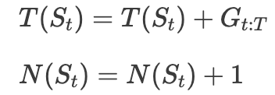
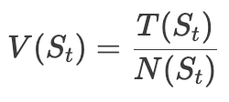
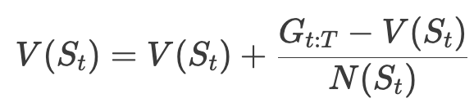

Monte Carlo prediction (2)
Once we have a trajectory, we can calculate the return
Then, add up the per-state returns and increment a count
Finally, we can estimate the expectation using the empirical mean (also incrementally)
As the counts approach infinity, the estimate will approach the true value

Slide 8

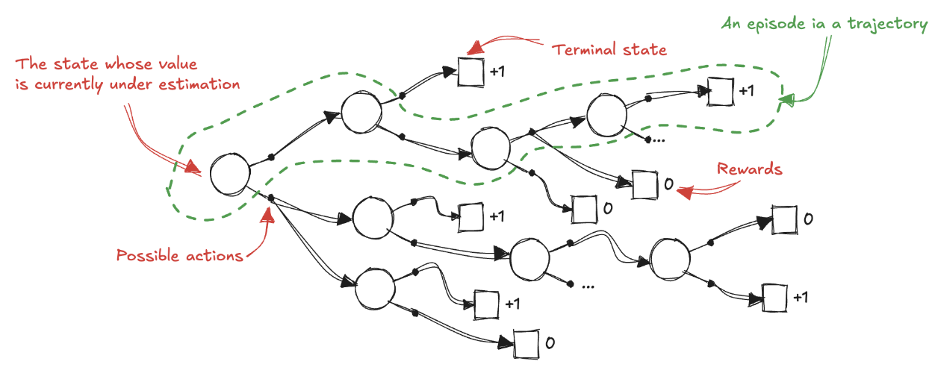
Monte Carlo prediction (3)
We can replace the mean for a learning rate
𝐺_{𝑡:𝑇} is the MC target
𝐺_{𝑡:𝑇} − 𝑉(𝑆_{𝑡}) is the MC error
Notice that V is calculated only at the end of an episode
because the returns depends on it

Slide 9
Monte Carlo prediction (4)
The learning value can be time dependant
this hyperparameter is essential
a constant alpha helps with learning in non-stationary environments
we can decay alpha to show convergence
A single trajectory may contain multiple visits to the same state
should we calculate the returns following each of those visits independently?
should we only use the first visit to each state?
Both are valid approaches, and they have similar theoretical properties
the more standard version is First-Visit Monte Carlo (FVMC)
convergence properties are easy to justify
Every-visit Monte Carlo (EVMC)
proven to converge also

Slide 10
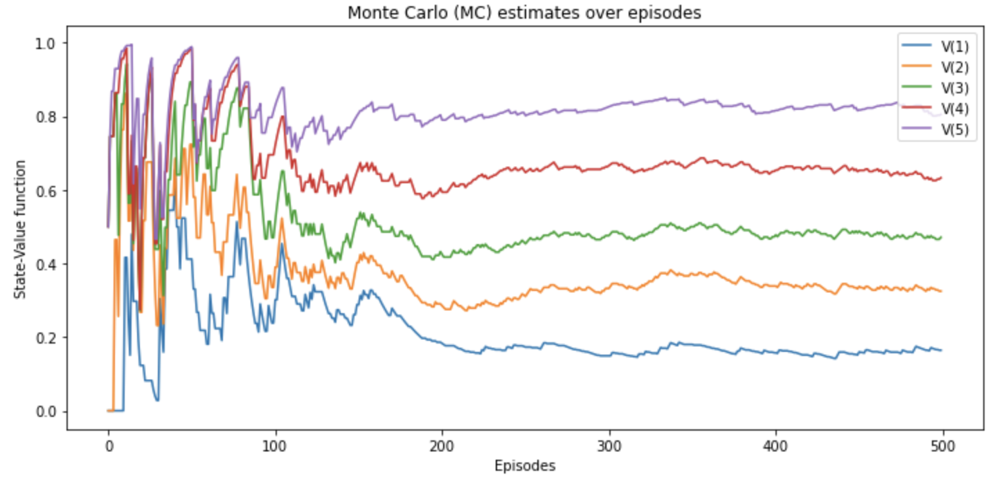
Monte-Carlo prediction (5)
MC convergence to the true values
running estimates are very noisy
jump back and forth around the true values

Slide 11
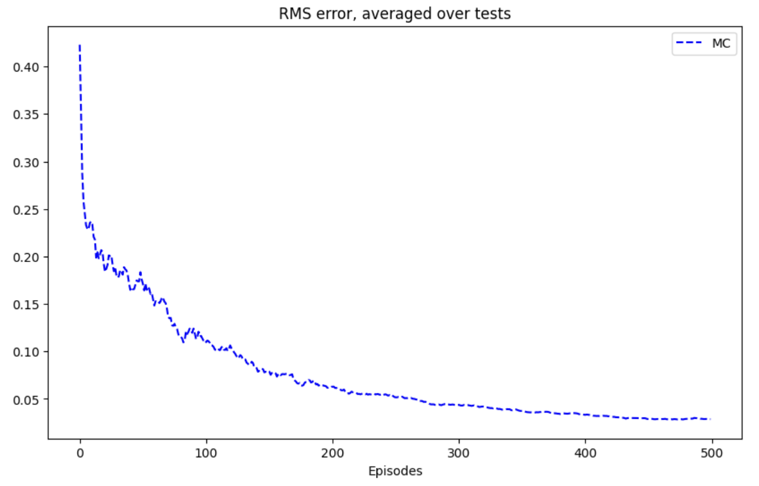
Monte-Carlo prediction (6)
Run an experiment over 100 runs
calculate the learning curves
measure the root mean-squared (RMS) error between the learned and the true values

Slide 12
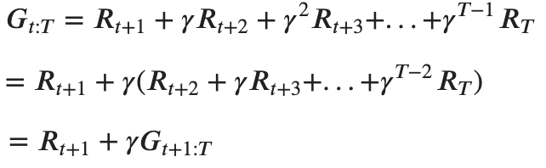
Temporal-Difference Learning (1)
In MC the agent must wait until the end of an episode before it can update the estimate
solid convergence properties: it updates the estimate using the actual return, which is an unbiased estimate
however, it has high-variance since actual returns accumulate many random events in their trajectory
Instead, we can wait for a single step
get a single-step reward R_{t+1}
observe the next state S_{t+1}
use the current V to estimate the return at the next step

Slide 13




Temporal-Difference Learning (2)
This means we could estimate the final return on every time step
we use the subscript to indicate how many real rewards are used to calculate the return
t:T means all rewards from t until the end (MC)
t:t+1 means just the next reward (TD)
Then we can substitute in the formula for the evaluation of the state-value function:
is the TD target
is the TD error

Slide 14
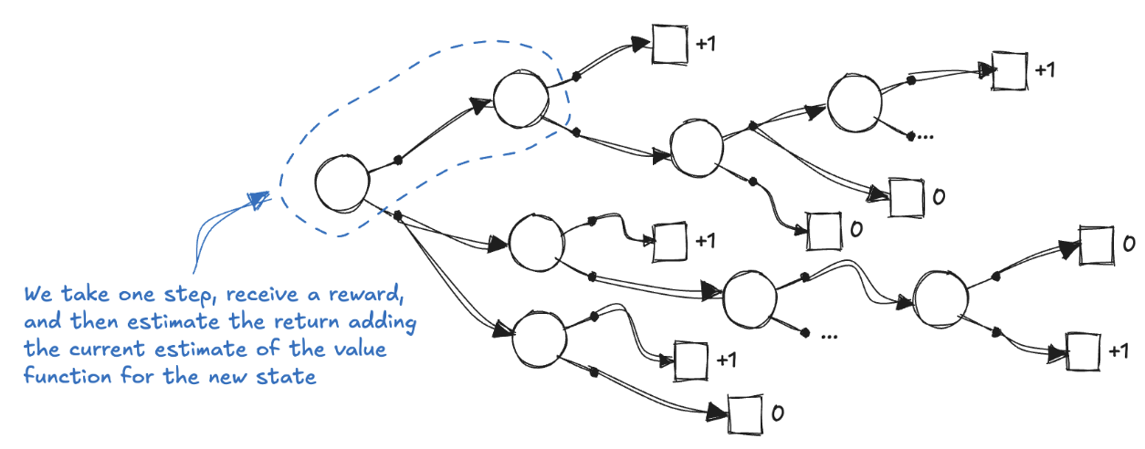
Temporal-Difference Learning (3)
TD estimates the value function using an estimate of the value function
reward signal progressively injects reality into the estimates
bootstrapping

Slide 15
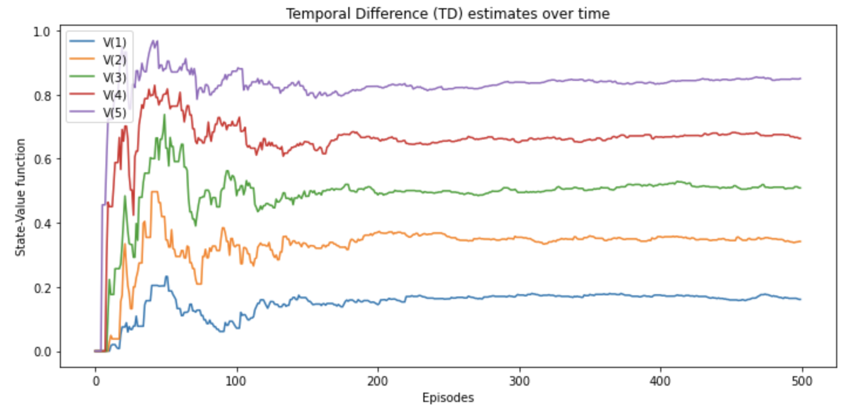
Temporal-Difference Learning (4)
It is a combination of MC and DP ideas
like Monte Carlo, it learn directly from raw experience (without a model)
like dynamic programming, it update estimates based on other learned estimates (without waiting for a final outcome)

Slide 16
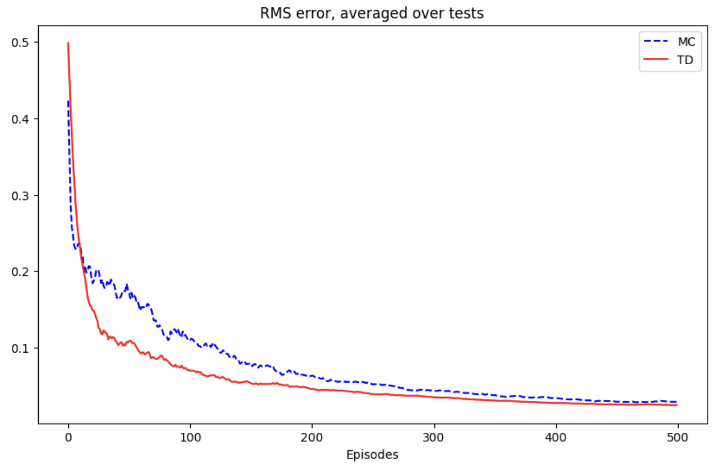
Temporal-Difference Learning (5)

Slide 17
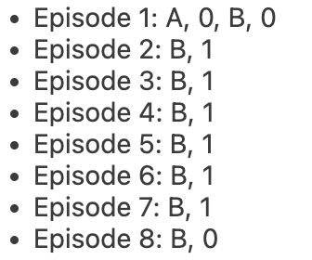
Batch updating (1)
Suppose there is available only a finite amount of experience
a common approach is to present the experience repeatedly until the method converges upon an answer
Suppose we observe the following episodes:
first episode started in A, transitioned to B and terminates with a reward of 0
other episodes were shorter, starting from B and terminating immediately
What are the optimal estimates V(A) and V(B)?
probably we agree that the optimal value for V(B) is 3/4
six times process terminates with a return of 1; two times terminated with 0
but what is the optimal value for V(A)?

Slide 18
Batch updating (2)
Two reasonable answers
all the times the process was in A, it travers to B and because we have decided that V(B) is 3/4 , therefore A have value 3/4 as well
this is the answer that TD gives
we have seen A once and the return that followed it was 0, we therefore estimate V(A) as 0
this is the answer that MC gives
it is also the answer that gives minimum squared error on the training data
However, we expect the first answer to be better: will produce lower error on future data
A general difference between TD and MC methods
MC always find the estimates that minimize mean-squared error on the training set
TD always finds the estimates for a model of the Markov process

Slide 19
Batch updating (3)
The TD model is formed from the observed episodes
estimated transition probability from i to j is the fraction of observed transitions from i that went to j
the associated expected reward is the average of the rewards observed on those transitions
Given the model, we can compute the estimate of the value function that would be correct if the model were correct
This helps to explain intuitively why TD method converges more quickly than MC method

Slide 20
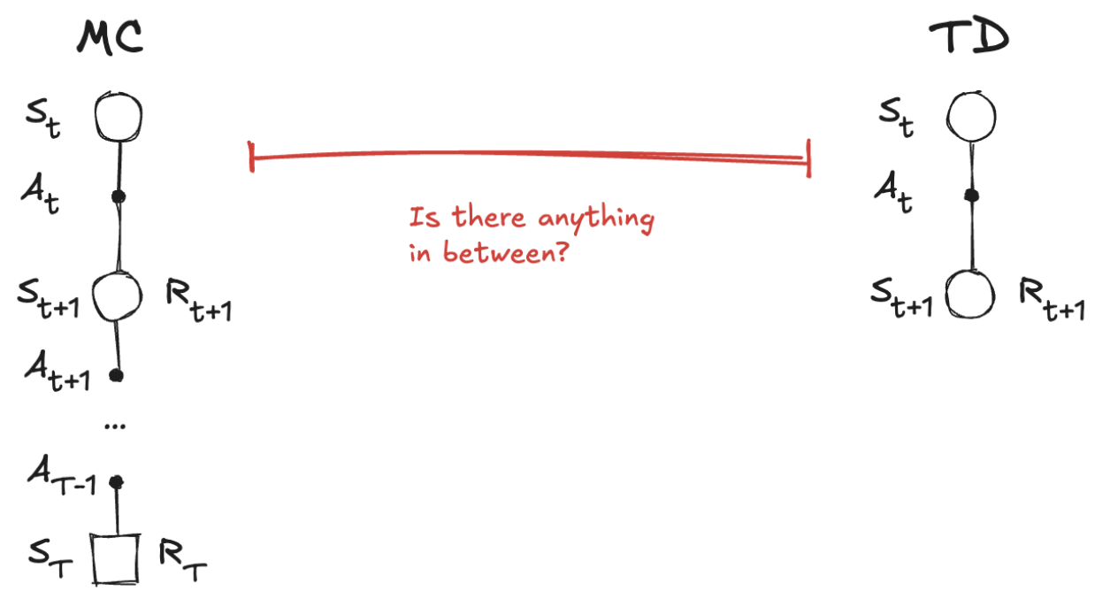
n-steps TD (1)
There something in between?
MC samples the environment all the way through the end of the episode before it estimates the value function
TD interacts with the environment only once, and it estimates the value function
How about bootstrapping after two steps? Three? Four?
there’s a spectrum of algorithms lying in between MC and TD
we can tune how much bootstrapping, letting us balance bias and variance

Slide 21

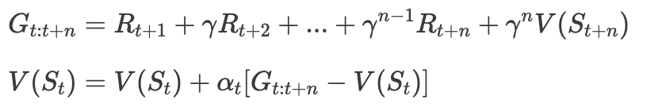
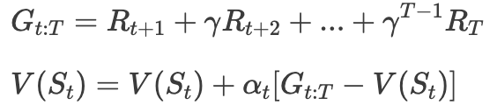


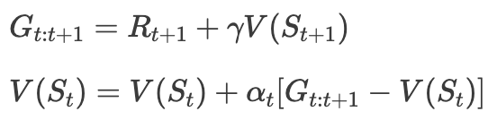
n-steps TD (2)
Two extremes:
MC is an infinite-step method: goes all the way until the end of the episode
TD is a one-step method: interacts with the environment for a single step
We can generalize into an n-step method
instead of doing a single step or the full episode, it uses n-steps
and then it makes the estimation
is the n-step TD target
is the n-step TD error
MC
TD

Slide 22
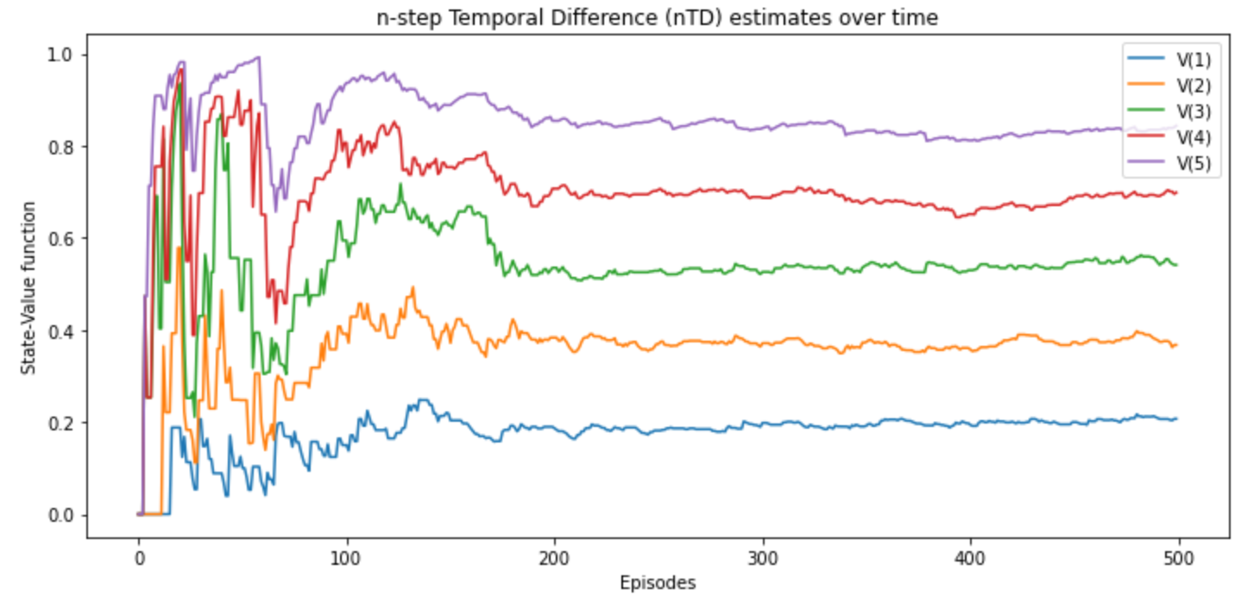
n-steps TD (3)

Slide 23
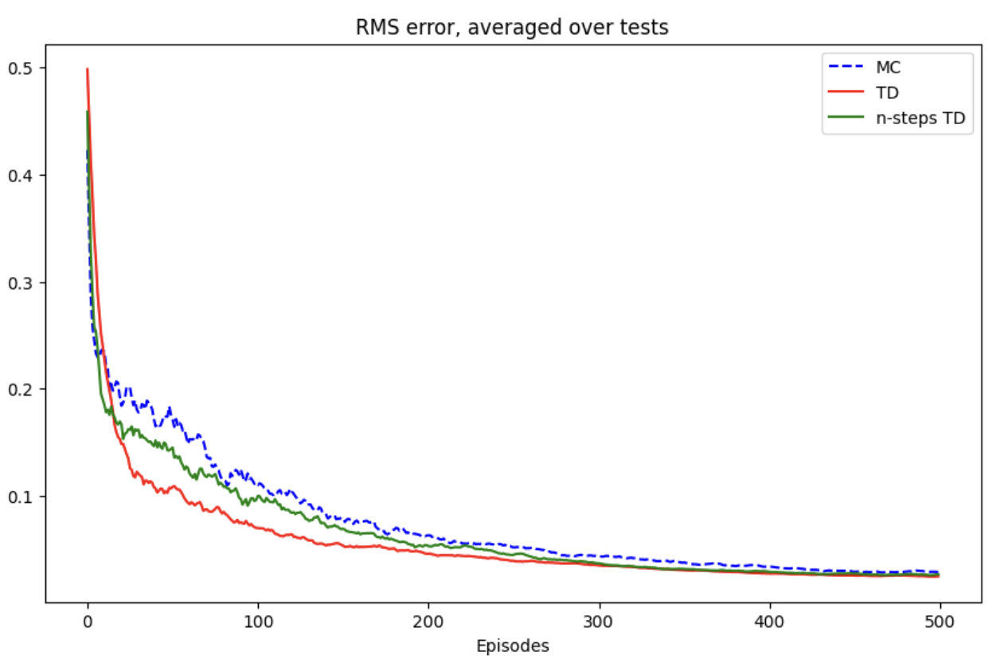
n-steps TD (4)

Slide 24
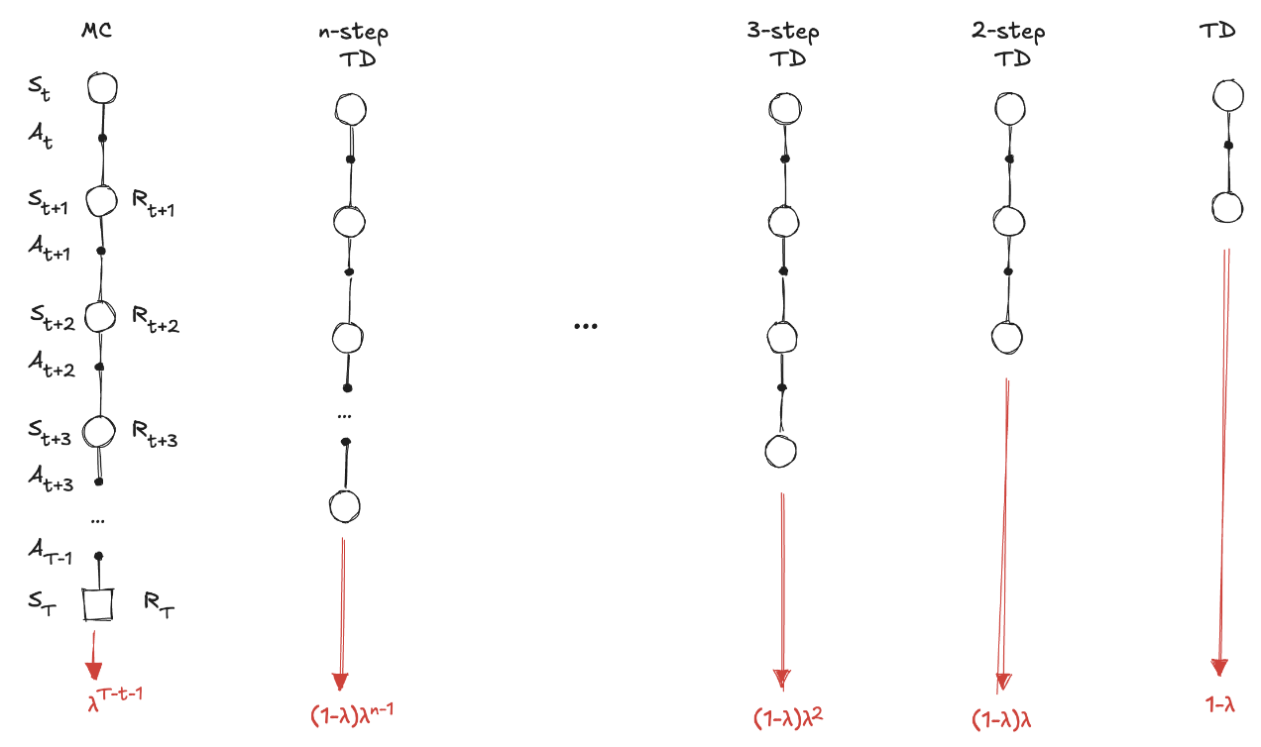
TD(𝜆) (1)
A question emerges: what is a good n?
How using a weighted combination of all n-step targets
agent could go out and calculate the targets corresponding to the one-, two-, three-, ..., infinite-step

Slide 25
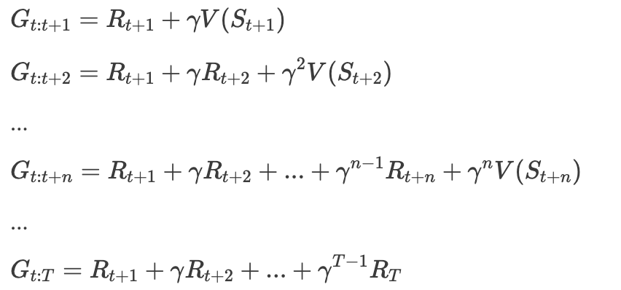
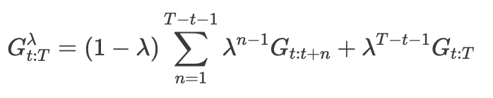



TD(𝜆) (2)
We can compose all targets using a weighted sum
We can evaluate the estimate of the value function using this return:
is the TD(lambda) target
is the TD(lambda) error

Slide 26



Backward-view TD( 𝜆 ) (1)
With TD(𝜆) we must wait until the end of an episode (like MC)
We can split the updates into partial updates
we track states that are eligible for an update on every step and by how much
Mechanism called eligibility traces
at the begging of every new episode, we set the eligibility vector to zero E=0
we interact with the environment one cycle (S_{t}, A_{t}, R_{t+1}, S_{t+1})
when we encounter a state, we add a one to its trace E(S_{t}) = E(S_{t}) + 1
to make it eligible for an update
we calculate the TD error:
we update the value function for all states using the eligibility trace vector
only eligible will get updated:
after the update, the eligibility trace vector is decayed
so future reinforcing events have less impact on earlier states:
Recent states get more significant credit for a reward encountered in a recent transition than those states visited earlier

Slide 27
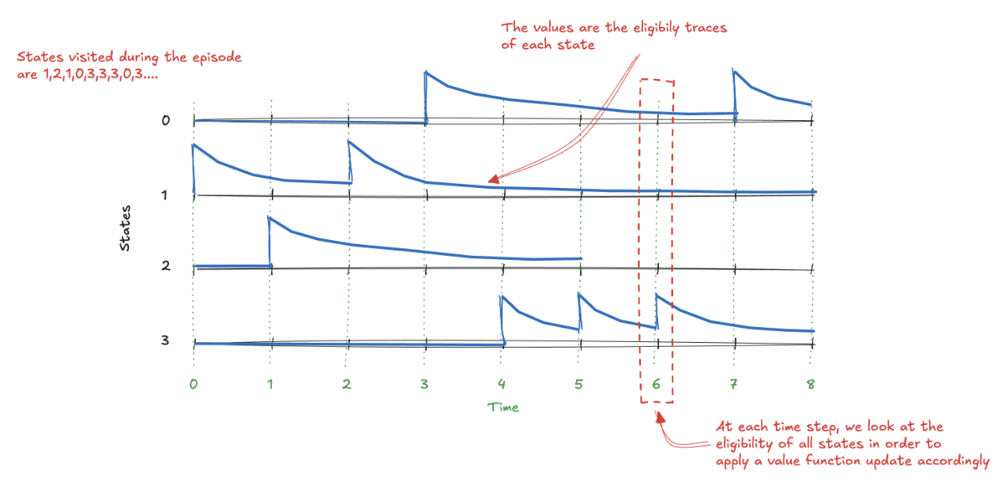
Backward-view TD( 𝜆 ) (2)

Slide 28
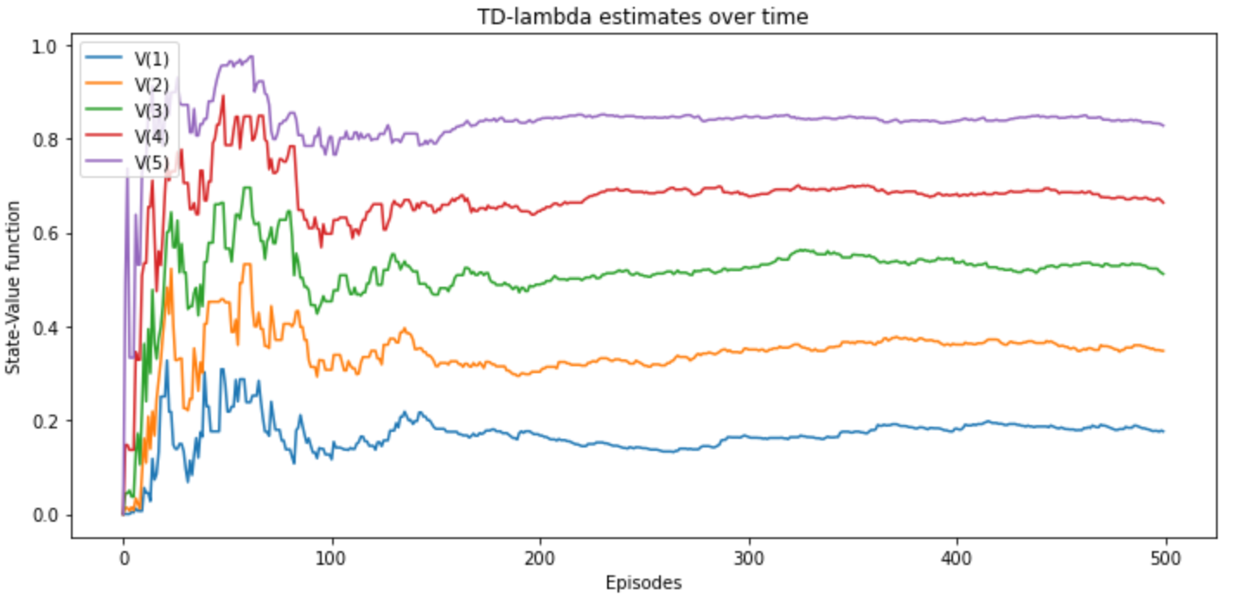
Backward-view TD( 𝜆 ) (3)
Notice that
TD(𝜆) when 𝜆=0 is equivalent to the TD method: TD(0)
TD(𝜆) when 𝜆=1 is equivalent to MC: TD(1)

Slide 29
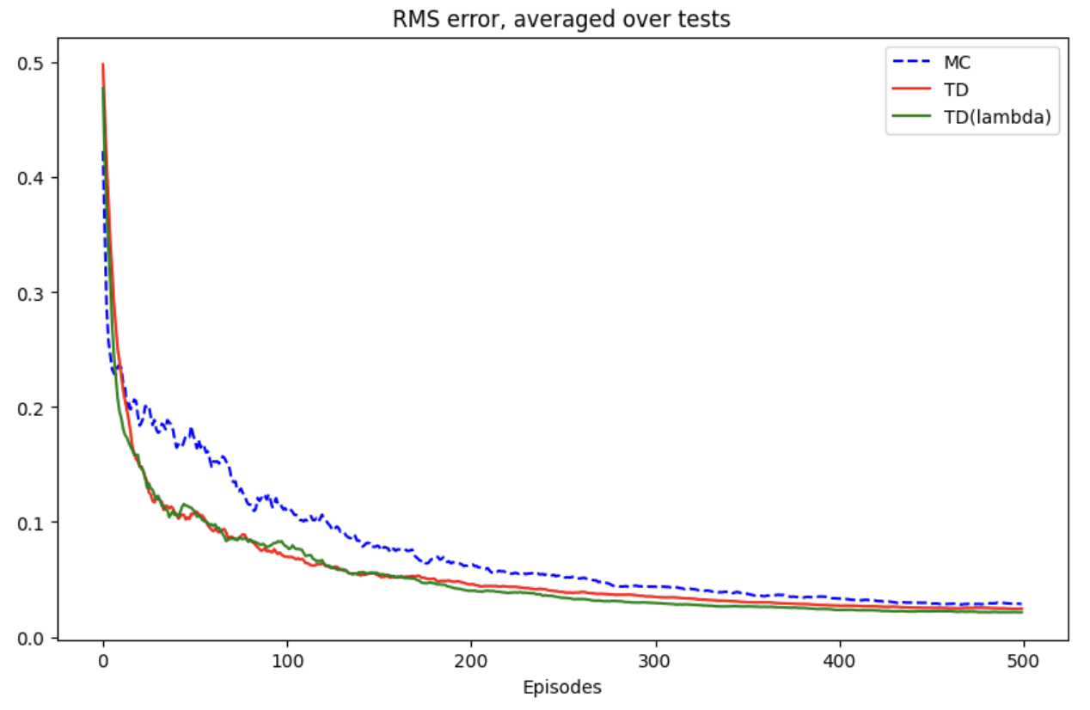
Backward-view TD( 𝜆 ) (3)

